Slide 2
Research should be focused
Almost all research should begin with a clear definition of the problem or question to be addressed.
Problem: Dr. Mason’s car broke down and it’s too expensive to fix.

Slide 3
Research should be focused
Almost all research should begin with a clear definition of the problem or question to be addressed.
Problem: Dr. Mason’s car broke down and it’s too expensive to fix.
Having goals or specific questions allows you to decide what sources/methods/ depth of research is necessary.

Slide 4
Research Terminology
Primary Research: Gathering raw data firsthand. Includes observations, interviews, experiments, testing, questionnaires
Using a valid research methodology and recording useful information are key here
Secondary Research: gathering information or data that’s already been compiled with, analyzed, evaluated or otherwise organized. Includes books, articles, web documents, business documents, brochures, etc.
Evaluating your source is key here.

Slide 5
The Internets (all of them)
the open Web
Invisible, Hidden Web, Gated Web
Infomine http://infomine.ucr.edu/
Librarian’s Internet Index http://lii.org/
FAU Library

Slide 6
Research strategies, search engines
Understanding search engines; algorithms
Keywords and synonyms
Boolean operators
Beware:
Google bombing
Other misleading manipulations (try “whois” search)
.org, .edu

Slide 7
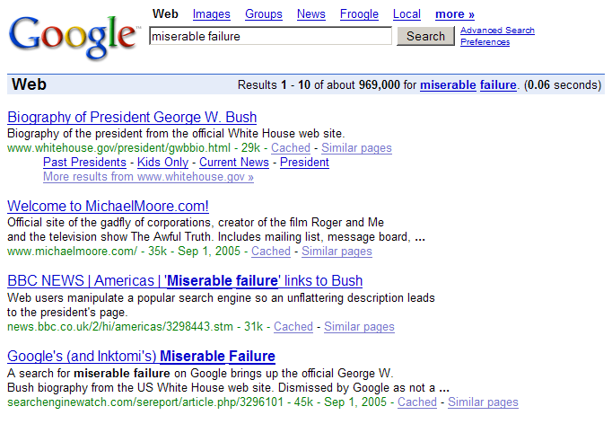

Slide 8
Determining Source Credibility
Authority, accuracy, bias, currency
CARS Method
Credibility: source listed, reputation, professionalism
Accuracy: facts accurate, site updated, written well
Reasonableness: objective statements, labeled biases, purpose of website
Support: well documented sources, updated links

